Slide 1

Reproducible Analytical Pipelines (RAPs)
A beginner’s guide to setting one up in DHSC

Slide 2
What are RAPs?
Data Store
Statistical Software
Spreadsheet
Presentation in word/ppt
Output as pdf
Export
Copy Paste
Copy Paste
Manual convert
At minimum a RAP should:
Improve version control preferably using git
Deepen quality assurance through peer review
Use open source software like R
Reduce manual copy pasting
Data Store
RAP
Output as pdf

Slide 3
Aims of today:
Understand the benefits of RAPs
A practical example of RAP
Setting up your own RAP
To get you RAPping!
Tools you’ll need to get started:
Github account
R installed
Power Bi installed
Notes:
*focus will be more on flows and automation than actual creation of code or dashboards

Slide 4
A practical example of RAP:
Published Vaccination Stats
Monitor daily at 2pm
Copy paste from web to spreadsheet
Spreadsheet tables
Copy paste data into tables
Format and calculations
Email to stakeholders
Email everyone on list
Copy paste tables from spreadsheet
From this
R automated web scrape
Use R to web scrape
Power Bi tables
Use scheduled refresh to pull github data into Power Bi
Format and calculate in Power Bi DAX
Subscription
Use automated emails after refresh to email stakeholders
Use github actions to automate web scraping
Tables are automatically attached to everyone
To this

Slide 5
Step 1: Automated web scraping with R
1a. Write web scraping code in R
1b. Automate web scraping
See past C&C session for the code here
Publish code on github for version control
Peer review code on github using a pull request
Use github actions to schedule running of R scripts
Caveats:
You can only do this step using published data
You cannot do this if you make any changes to published data

Slide 6
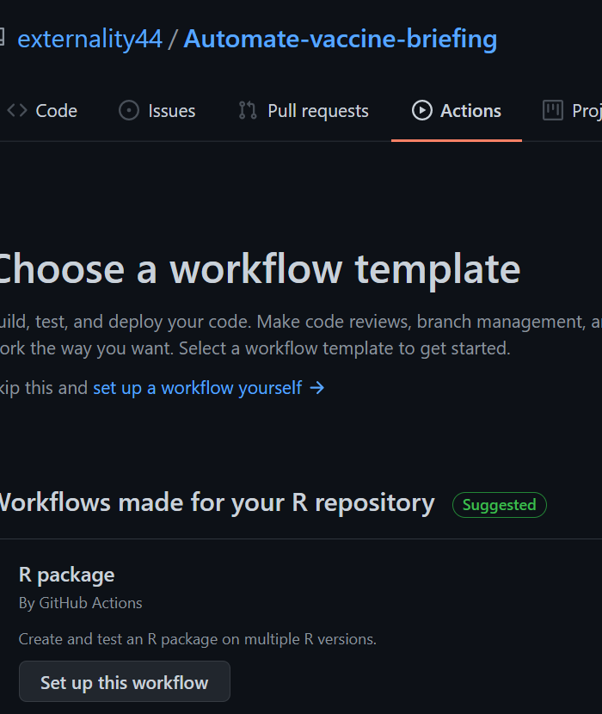
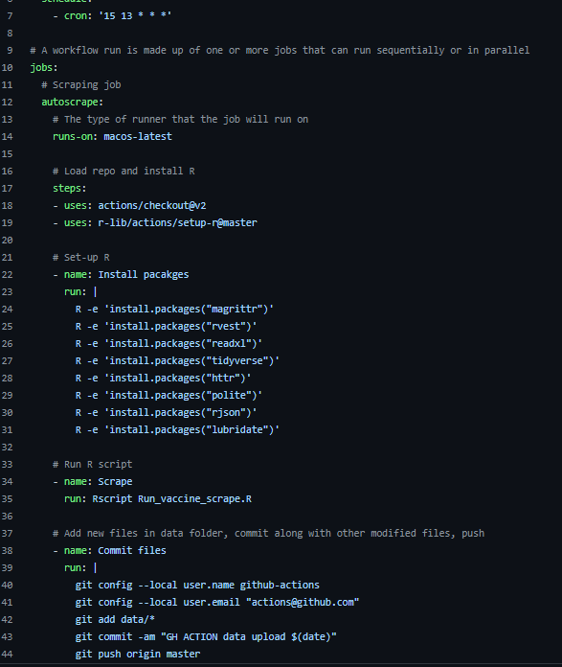
1b. Automate web scraping
See here for the github automation script I used (click on github/workflows > vaccinescrape.yml)
Under the Actions ribbon click on ‘set up a workflow yourself’
Name your yml file and set a time to run your R scripts
Make sure you install all the packages you use in your scripts
Make sure you commit template of the files which will be created by the scripts before you run actions

Slide 7
Pros and Cons
You can automate your R scripts!
Version control
Automated quality checks
Saves manual work time
You can only use this for published data as is (github is not allowed to host data)
You cannot test run – you have to wait till automated time to find out if the automation worked

Slide 8
Step 2: Set up your tables on Power Bi
2a. Use DAX to calculate table metrics
2b. Set scheduled refresh to get data from github
Calculate on Power Bi desktop
When you are done you can publish your report to the “Statistics and Data Science” workspace.
Published reports can be schedule refreshed so all the visuals are updated
Notes:
*focus is on flow rather than setting up dashboard

Slide 9
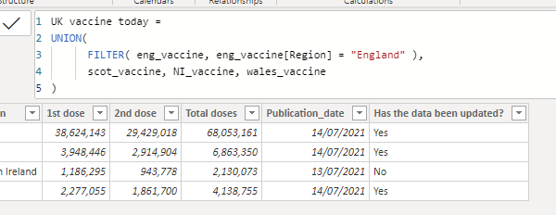
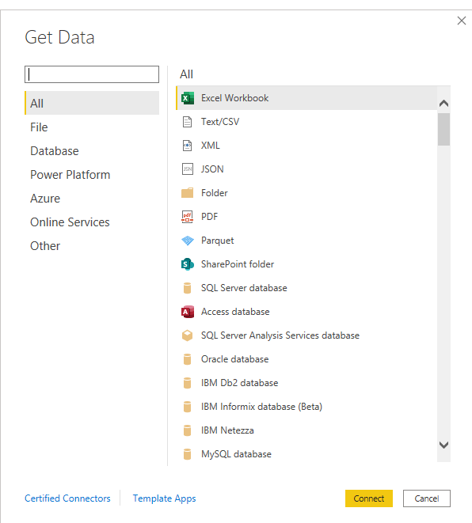
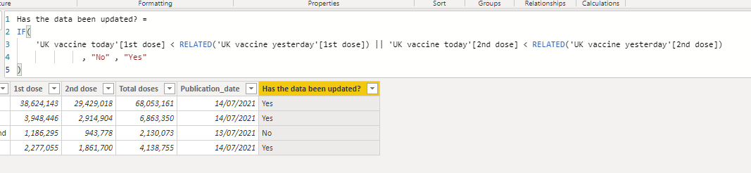
Step 2a: expanded
Get data from multiple sources
DAX is a powerhouse of calculations
Git
Sharepoint
Web
APIs
Join tables together
Create dummy variables

Slide 10
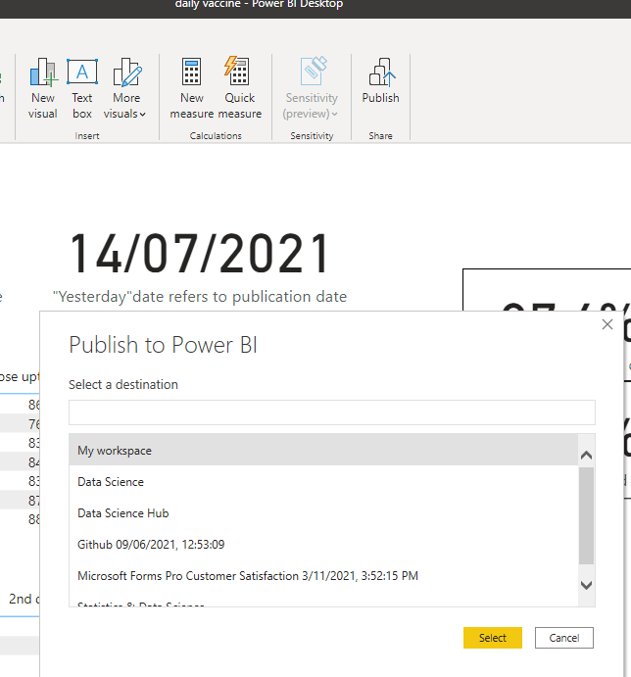
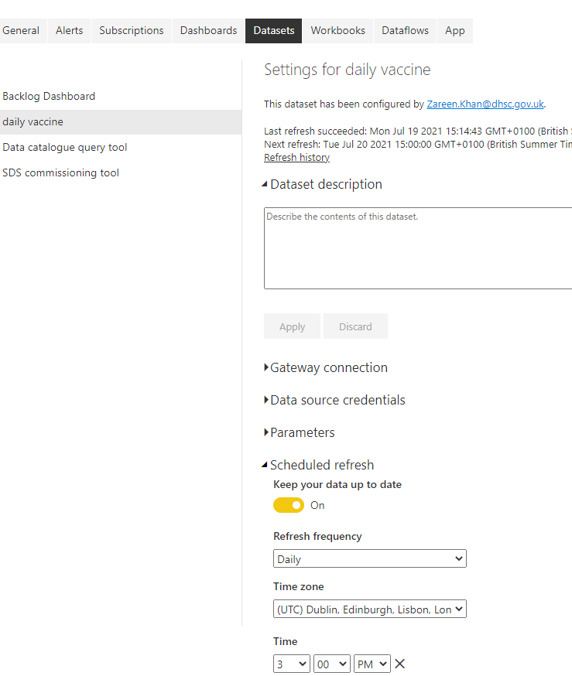
Step 2b: publish and schedule refresh
Publish on workspace
Schedule refresh of report
Make sure your data source credentials are updated

Slide 11
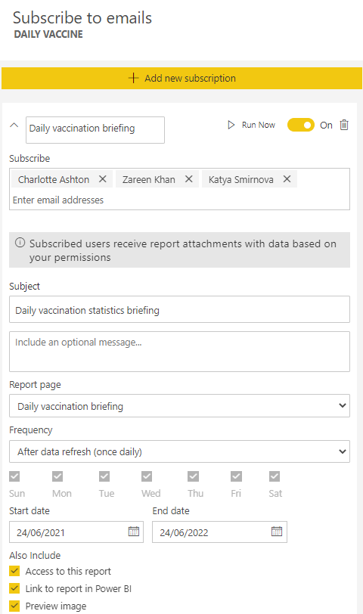
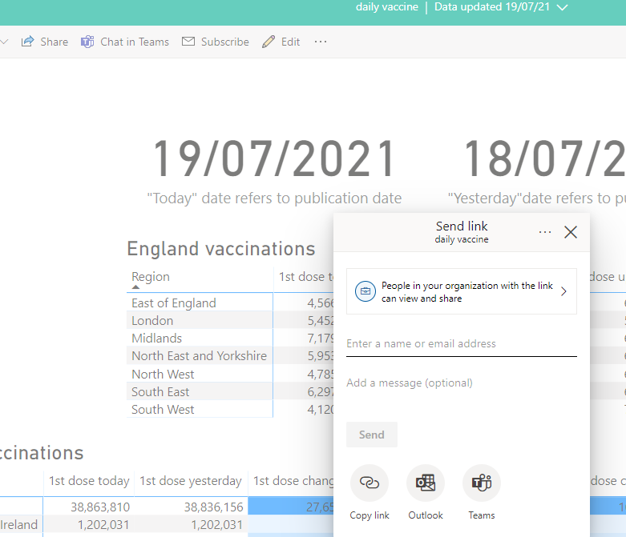
Step 3: Send report to stakeholders
Give the right people access

Slide 12
Let’s get you RAPping!
Open Power Bi desktop
Get any data from a sharepoint file
here is a guide on how to
Do at least one DAX calculation in Power Query editor
proportions/rates of change/joining tables etc.
Publish the report to your own workspace
Give someone from your team access to your report

Slide 13
More on RAP
To read analysts’ experiences of RAP please see:​
The Nature of RAP​
Ministry of Housing Communities and Local Government’s Blog​
https://gss.civilservice.gov.uk/reproducible-analytical-pipelines/​
Please get in touch by raising a ticket if you want us to help you upskill team members to transform legacy workflows into RAPs.

